Slide 1
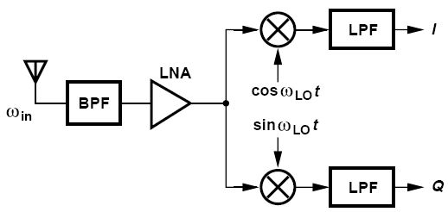
Direct-Conversion Receivers
Absence of an image greatly simplifies the design process
Channel selection is performed by on-chip low-pass filter
Mixing spurs are considerably reduced in number
Notes:
the RF spectrum is not simply translated to the baseband in the first downconversion. Called the
“direct-conversion,” “zero-IF,” or “homodyne” architecture.

Slide 2
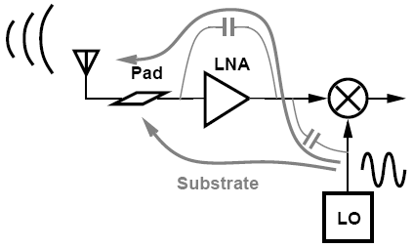
LO Leakage
LO couples to the antenna through:
(a)device capacitances between LO and RF ports of mixer and device capacitances or resistances between the output and input of the LNA
(b)the substrate to the input pad, especially because the LO employs large on-chip spiral inductors
Notes:
Does LO leakage occur in heterodyne receivers? Yes, but since the LO frequency falls
outside the band, it is suppressed by the front-end band-select filters in both the emitting
receiver and the victim receiver.

Slide 3
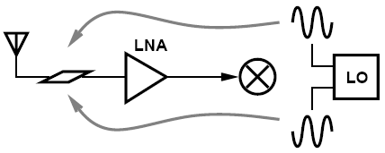
Cancellation of LO Leakage
LO leakage can be minimized through symmetric layout of the oscillator and the RF signal path
LO leakage arises primarily from random or deterministic asymmetries in the circuits and the LO waveform

Slide 4
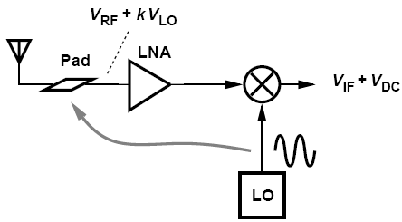
DC Offsets
A finite amount of in-band LO leakage appears at the LNA input. Along with the desired signal, this component is amplified and mixed with LO.
May saturates baseband circuits, simply prohibiting signal detection.
Notes:
Why is a dc component troublesome? It appears that, if constant, a dc term does not corrupt the desired signal. However, such a component makes the processing of the baseband signal difficult.
Such an offset saturates the baseband circuits, simply prohibiting signal detection.

Slide 5
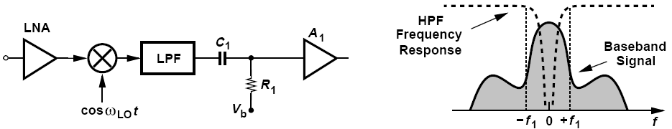
Cancellation of DC Offsets
Offset cancellation: high-pass filter
A drawback of ac coupling stems from its slow response to transient input.

Slide 6
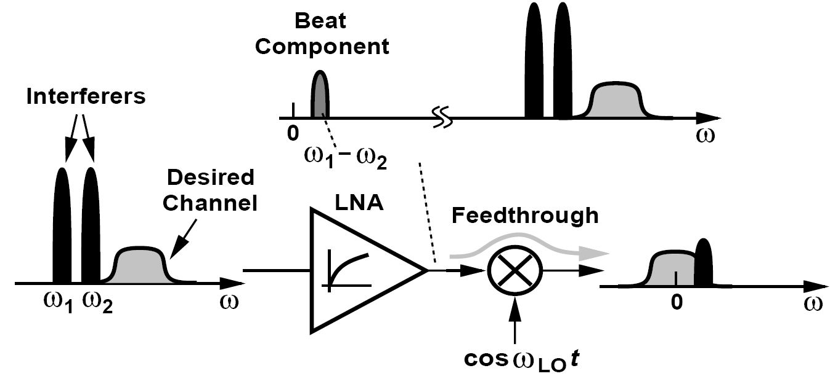
Even-Order Distortion: an Overview
Direct-conversion receivers are additionally sensitive to even-order nonlinearity in the RF path, and so are heterodyne architectures having a second zero IF.
Asymmetries in the mixer or in the LO waveform allow a fraction of the RF input of the mixer to appear at the output without frequency translation, corrupting the downconverted signal.
The beat generated by the LNA can be removed by ac coupling, making the input transistor of the mixer the dominant source of even-order distortion.
Notes:
Upon multiplication by cos ωLOt in an ideal mixer, such a term is translated to high frequencies and hence becomes unimportant. In reality, however,
asymmetries in the mixer or in the LO waveform allow a fraction of the RF input of the mixer to appear at the output without frequency translation.

Slide 7
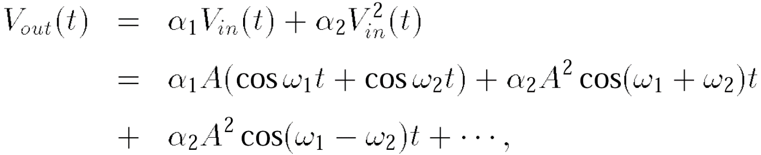
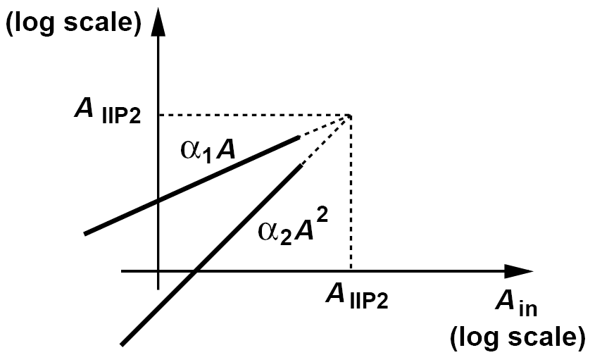
Second Intercept Point (IP₂)
If V_{in}(t) = Acos ω₁t + Acos ω₂t, then the LNA output is given by
Beat amplitude grows with the square of the amplitude of the input tones.

Slide 8
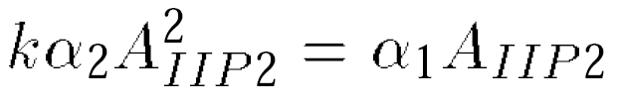
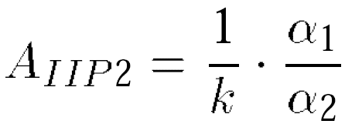
Example of Calculation of IP₂
Since the feedthrough of the beat depends on the mixer and LO asymmetries, the beat amplitude measured in the baseband depends on the device dimensions and the layout and is therefore difficult to formulate.
Suppose the attenuation factor experienced by the beat as it travels through the mixer is equal to k whereas the gain seen by each tone as it is downconverted to the baseband is equal to unity. Calculate the IP₂.
Solution:
From equation above, the value of A that makes the output beat amplitude, kα₂A2, equal to the main tone amplitude, α₁A, is given by
hence

Slide 9
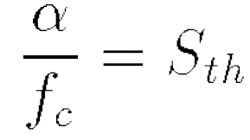
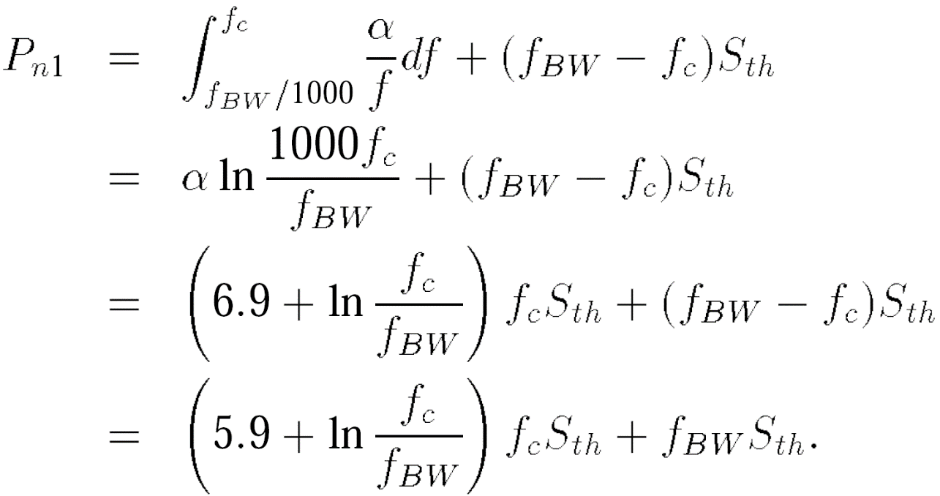
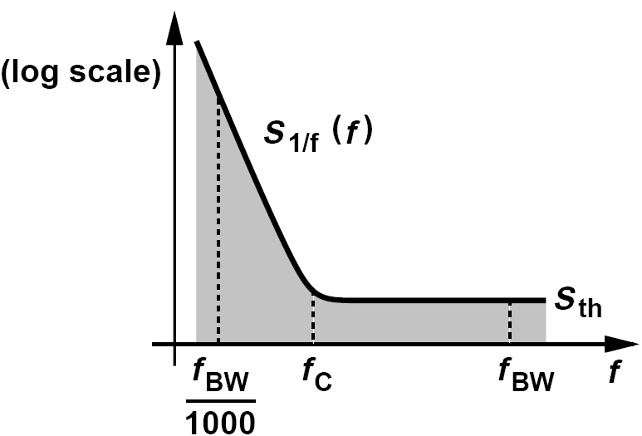
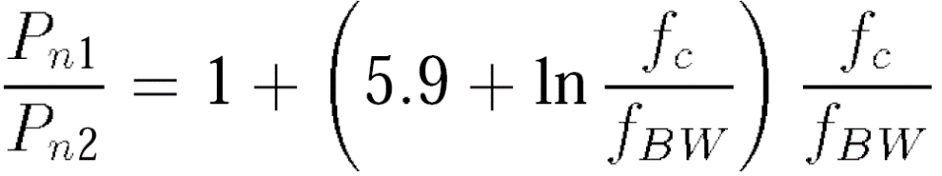

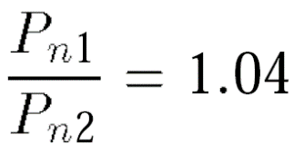
Flicker Noise
Since the signal is centered around zero frequency, it can be substantially corrupted by flicker noise.
We note that if S_{1/f} = α/f, then at f_{c},
An 802.11g receiver exhibits a baseband flicker noise corner frequency of 200 kHz. Determine the flicker noise penalty
We have f_{BW} = 10 MHz, f_{c} = 200 kHz, and hence
Notes:
fBW is half of the RF channel bandwidth. The flicker noise is denoted by S1/f and the thermal noise at the end of the baseband by Sth. The frequency
at which the two profiles meet is called fc. We wish to determine the penalty due to flicker.
We assume noise components below roughly fBW/1000 are unimportant because they vary so slowly that they negligibly affect the baseband symbols

Slide 10
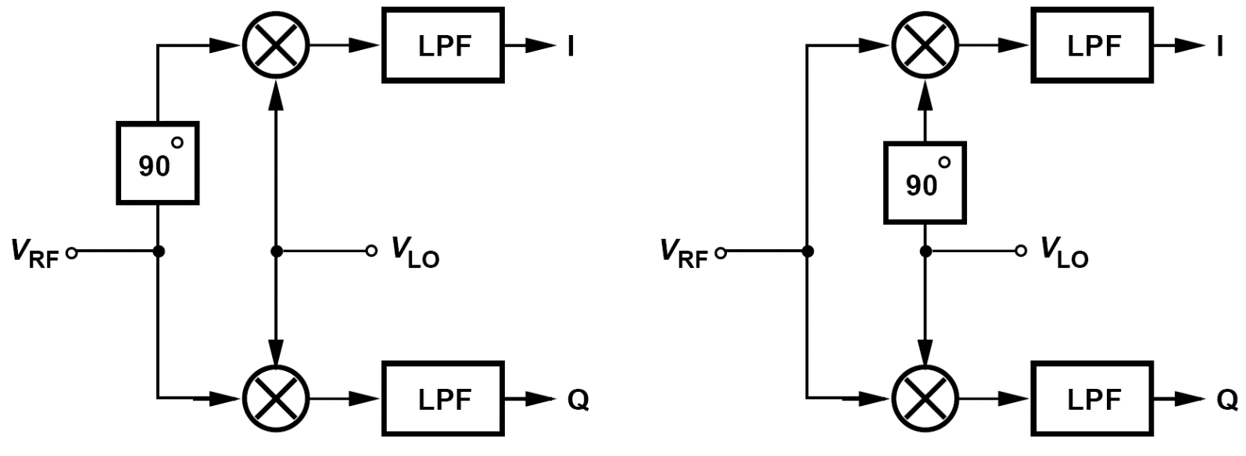
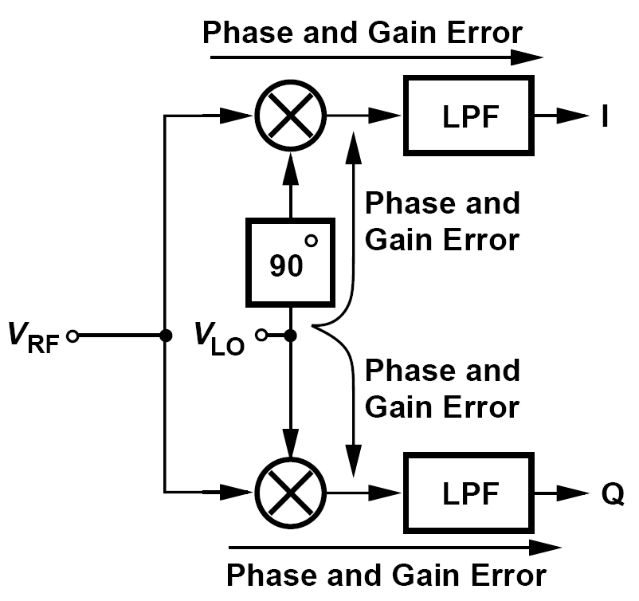
I/Q Mismatch: Sources
Separation into quadrature phases can be accomplished by shifting either the RF signal or the LO waveform by 90°.
Errors in the 90° phase shift circuit and mismatches between the quadrature mixers result in imbalances in the amplitudes and phases of the baseband I and Q outputs.

Slide 11
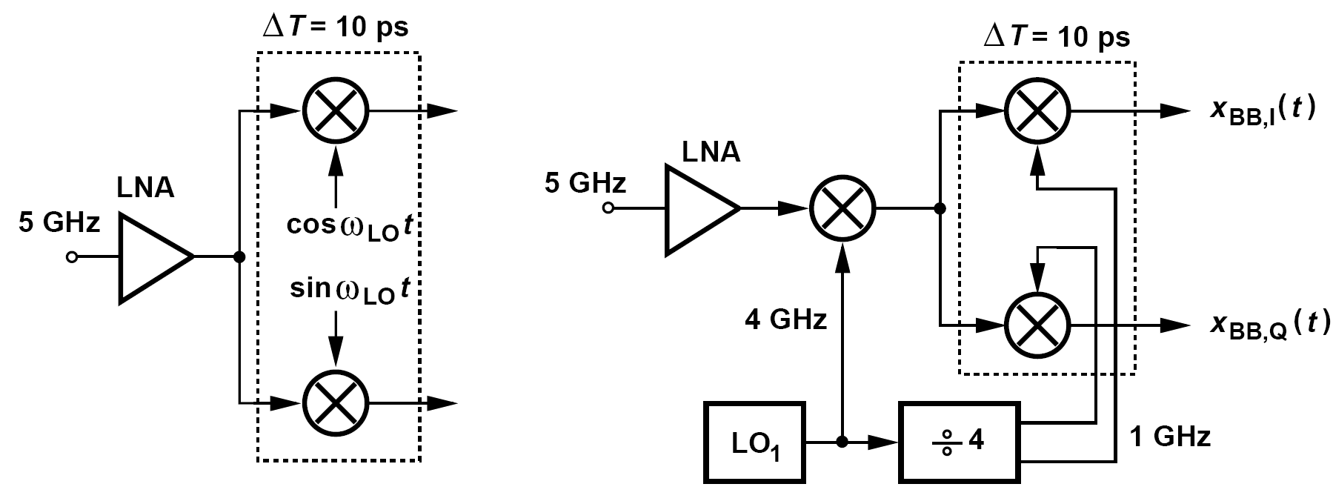
I/Q Mismatch in Direct-Conversion Receivers And Heterodyne Topologies
Quadrature mismatches tend to be larger in direct-conversion receivers than in heterodyne topologies.
This occurs because
(1) the propagation of a higher frequency (f_{in}) through quadrature mixers experiences greater mismatches;
(2) the quadrature phases of the LO itself suffer from greater mismatches at higher frequencies;
Notes:
a delay mismatch of 10 ps between the two mixers translates to a phase mismatch of 18 degree at 5 GHz and 3.6 degree at 1 GHz.

Slide 12
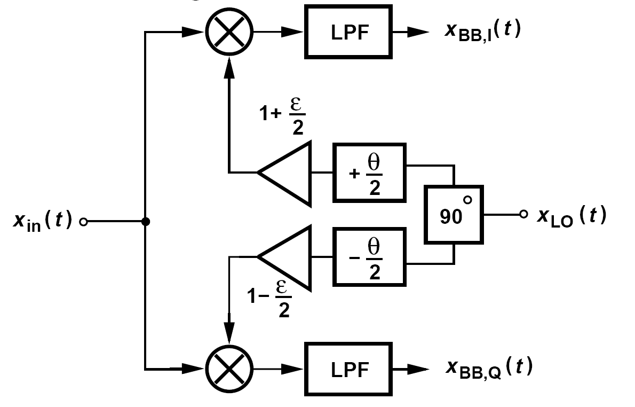

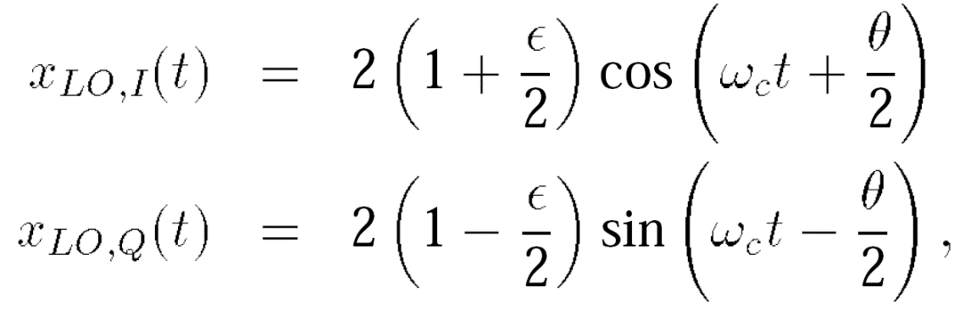
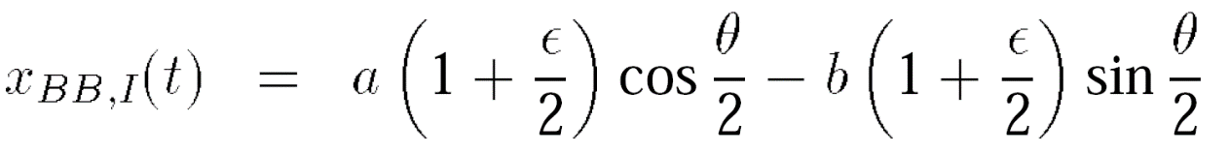
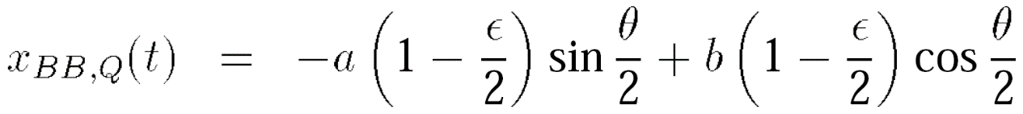
Effect of I/Q Mismatch (Ⅰ)
Let us lump all of the gain and phase mismatches shown below:
Notes:
x in(t)= a cos ωc t +b sin ωc t

Slide 13
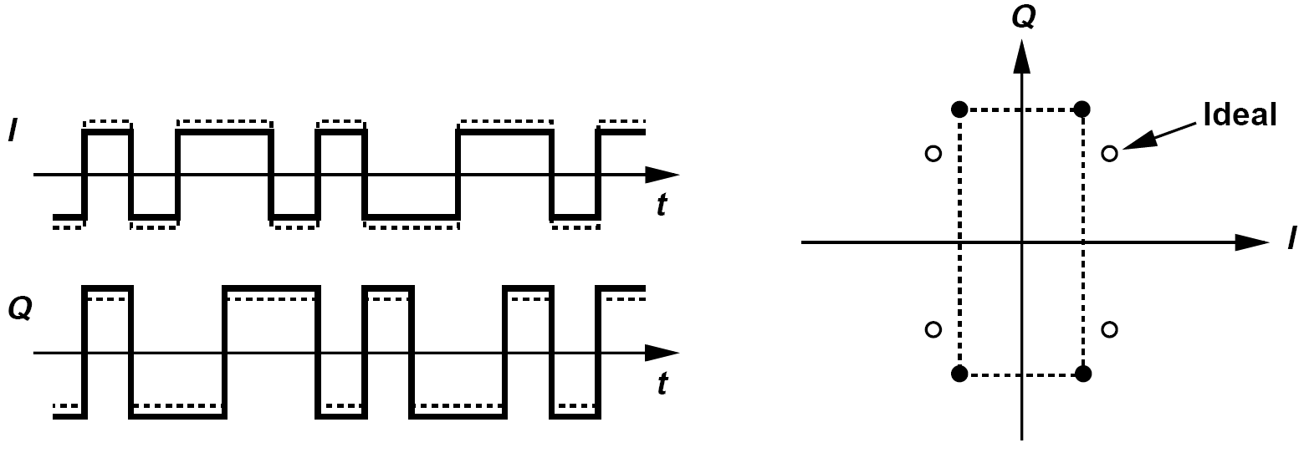
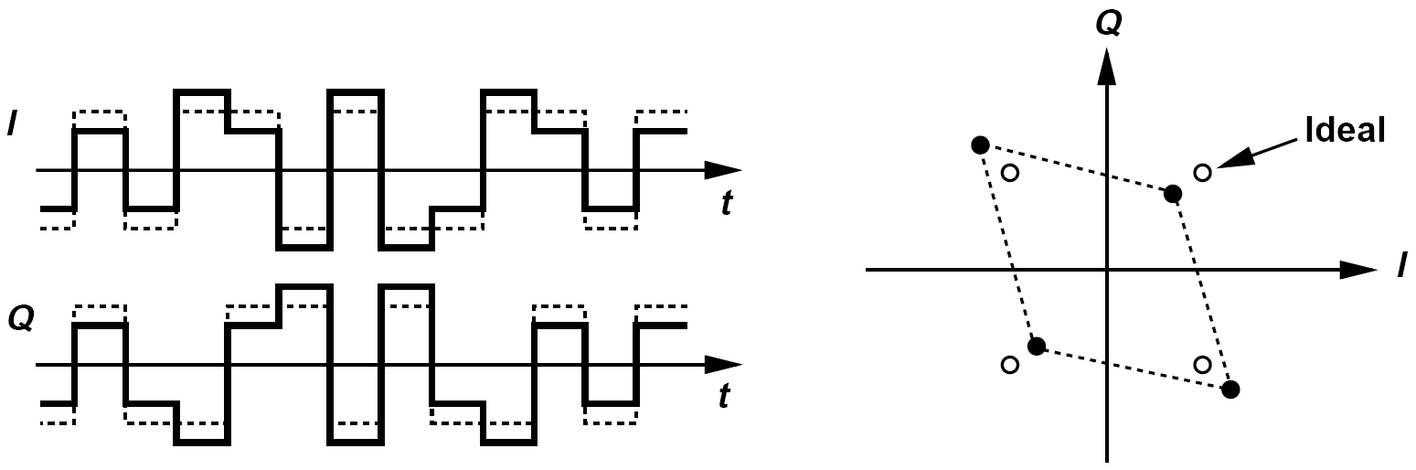
Effect of I/Q Mismatch (Ⅱ)
We now examine the results for two special cases:
(1) ε ≠ 0, θ = 0 : the quadrature baseband symbols are scaled differently in amplitude,
(2) ε = 0, θ ≠ 0 : each baseband output is corrupted by a fraction of the data symbols in the other output

Slide 14
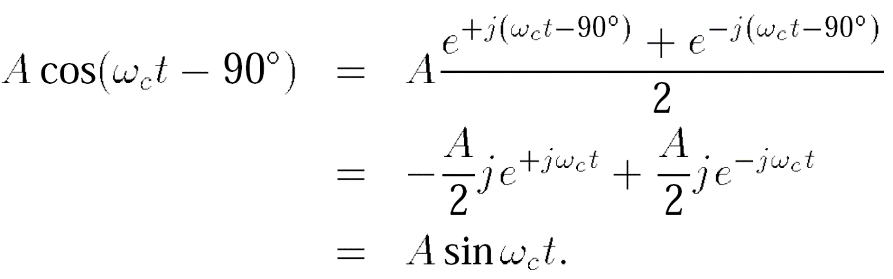
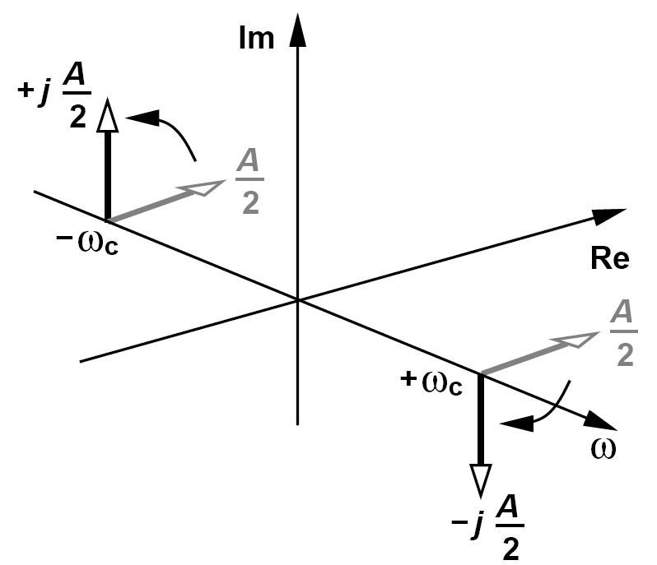
Image-Reject Receivers: 90 °Phase Shift—Cosine Signal
Before studying these architectures, we must define a “shift-by-90 °” operation.
The impulse at +ω_{c} is rotated clockwise and that at –ω_{c} counterclockwise

Slide 15
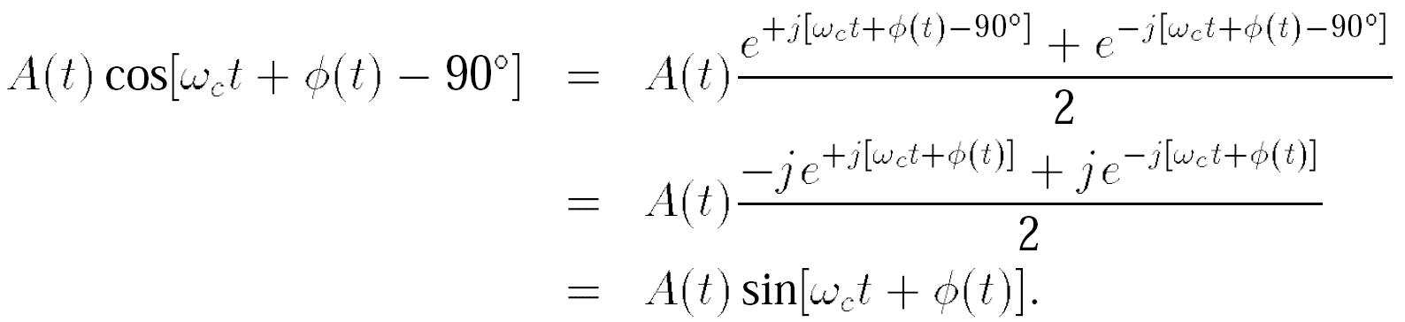
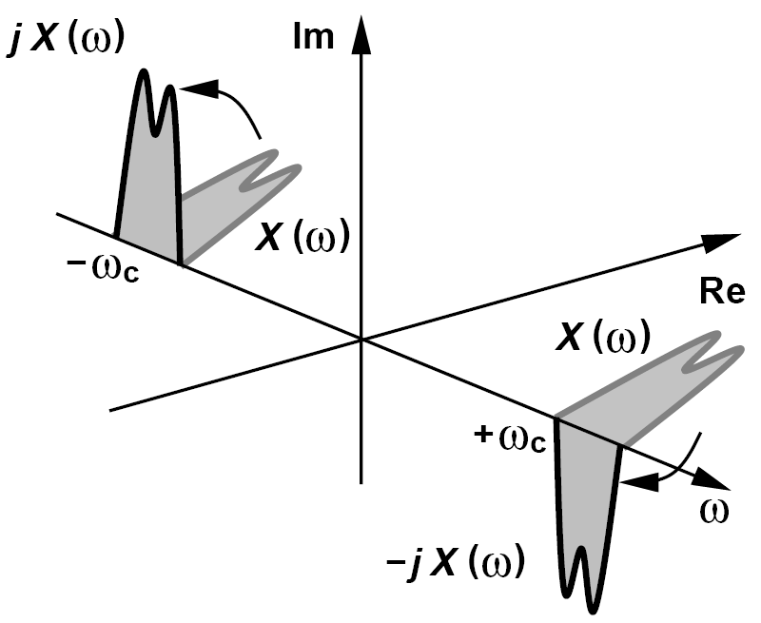
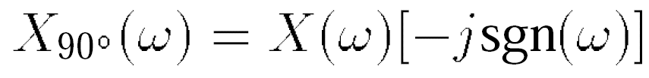
Image-Reject Receivers: 90 °Phase Shift—Modulated Signal
Similarly, for a narrowband modulated signal:
We write in the frequency domain:
The shift-by-90 ° operation is also called the “Hilbert transform”.

Slide 16
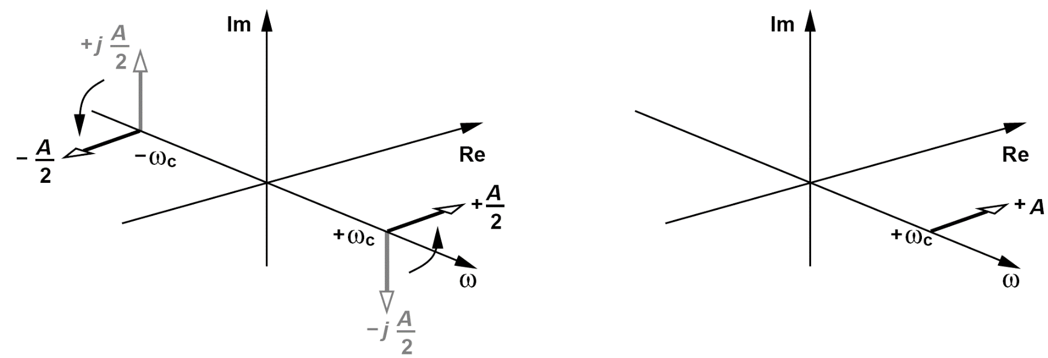
Examples of Hilbert Transform
In phasor diagrams, we simply multiply a phasor by -j to rotate it by 90° clockwise. Is that inconsistent with the Hilbert transform?
No, it is not. A phasor is a representation of Aexp(jω_{c}t), i.e., only the positive frequency content. That is, we implicitly assume that if Aexp(jω_{c}t) is multiplied by -j, then Aexp(-jω_{c}t) is also multiplied by +j.
Plot the spectrum of Acos ω_{c}t + jA sinω_{c}t.
Multiplication of the spectrum of Asinω_{c}t by j rotates both impulses by 90 ° counterclockwise. Upon adding this spectrum to that Acos ω_{c}t, we obtain the one-sided spectrum shown below (right). This is, of course, to be expected because Acos ω_{c}t + jA sinω_{c}t = Aexp(-jω_{c}t), whose Fourier transform is a single impulse located at ω = +ω_{c}.

Slide 17
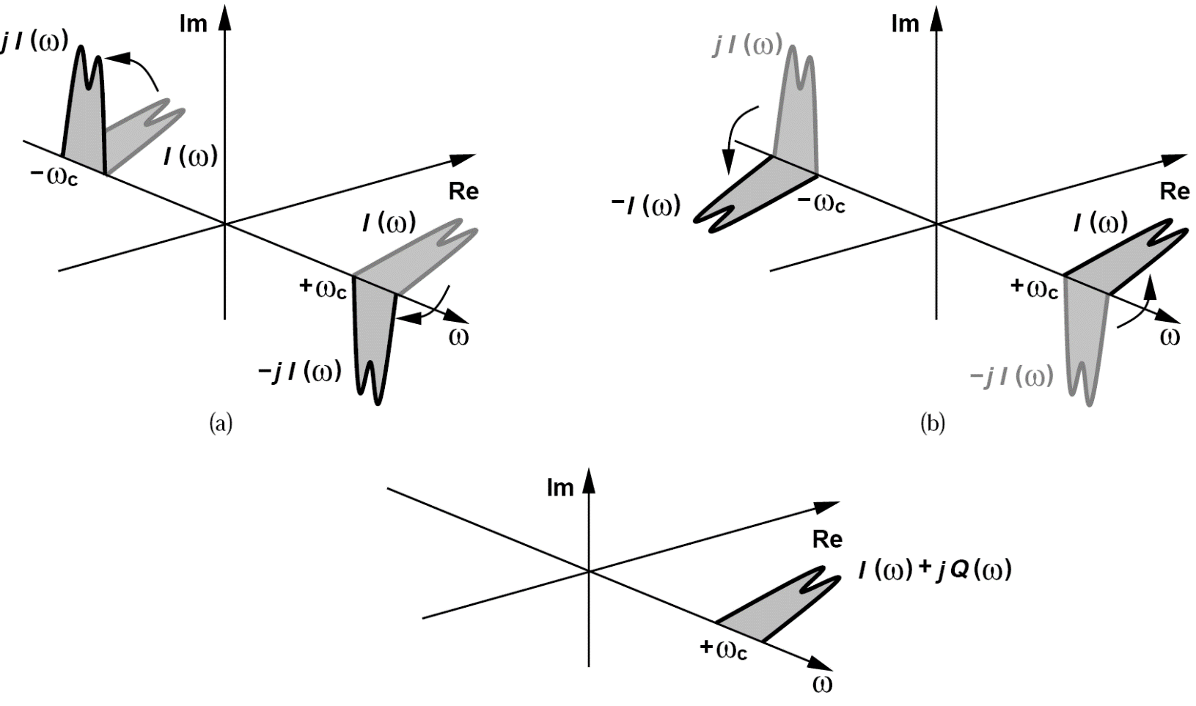
Example of I + jQ
A narrowband signal I(t) with a real spectrum is shifted by 90 ° to produce Q(t). Plot the spectrum of I(t) + jQ(t).
We first multiply I(ω) by -jsgn(ω) and then, in a manner similar to the previous example, multiply the result by j. The spectrum of jQ(t) therefore cancels that of I(t) at negative frequencies and enhances it at positive frequencies. The one-sided spectrum of I(t) + jQ(t) proves useful in the
analysis of
transceivers.

Slide 18
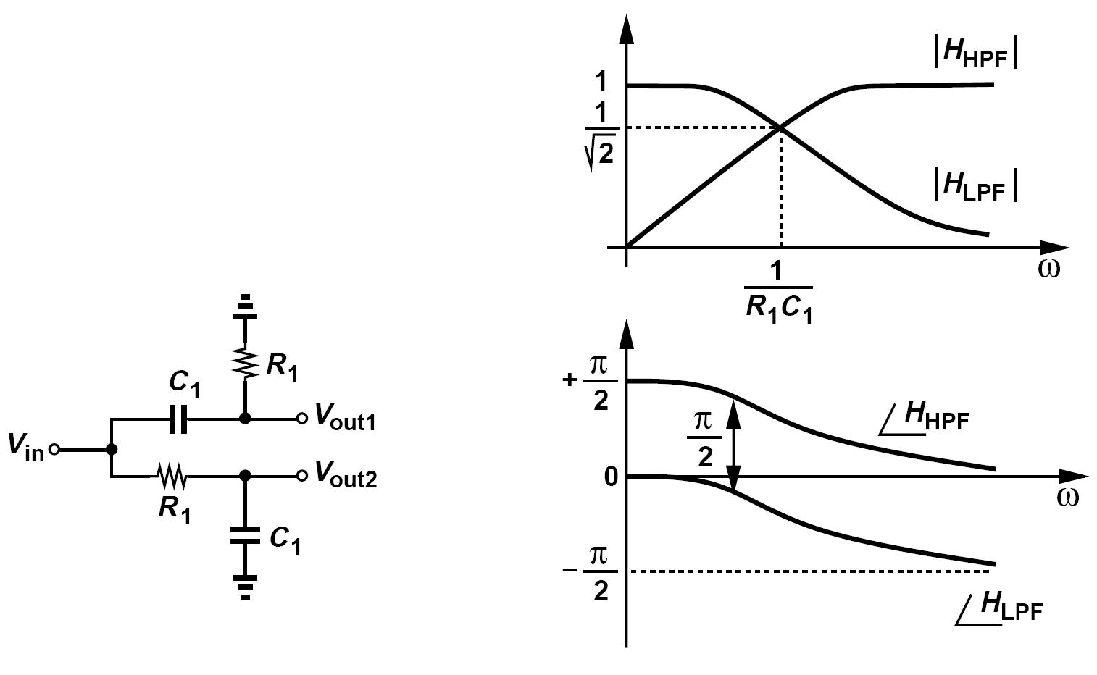
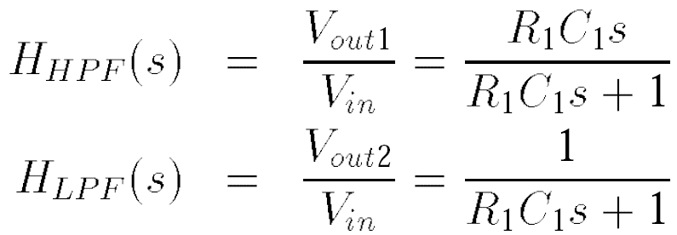
Implementation of the 90° Phase Shift
The high-pass and low-pass transfer functions are respectively given by:
We can therefore consider V_{out2} as the Hilbert transform of V_{out1} at frequencies close to (R₁C₁)-1

Slide 19
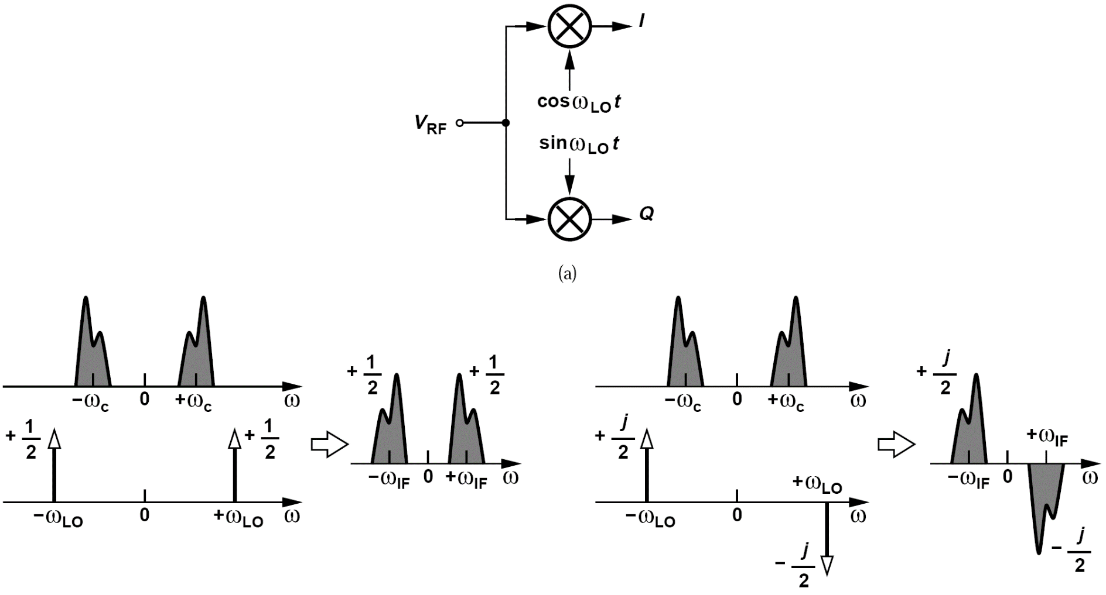
Another Approach to Implement the 90° Phase Shift
The RF input is mixed with the quadrature phases of the LO so as to translate the spectrum to a non-zero IF.
The IF spectrum emerging from the lower arm is the Hilbert transform of that from the upper arm.

Slide 20
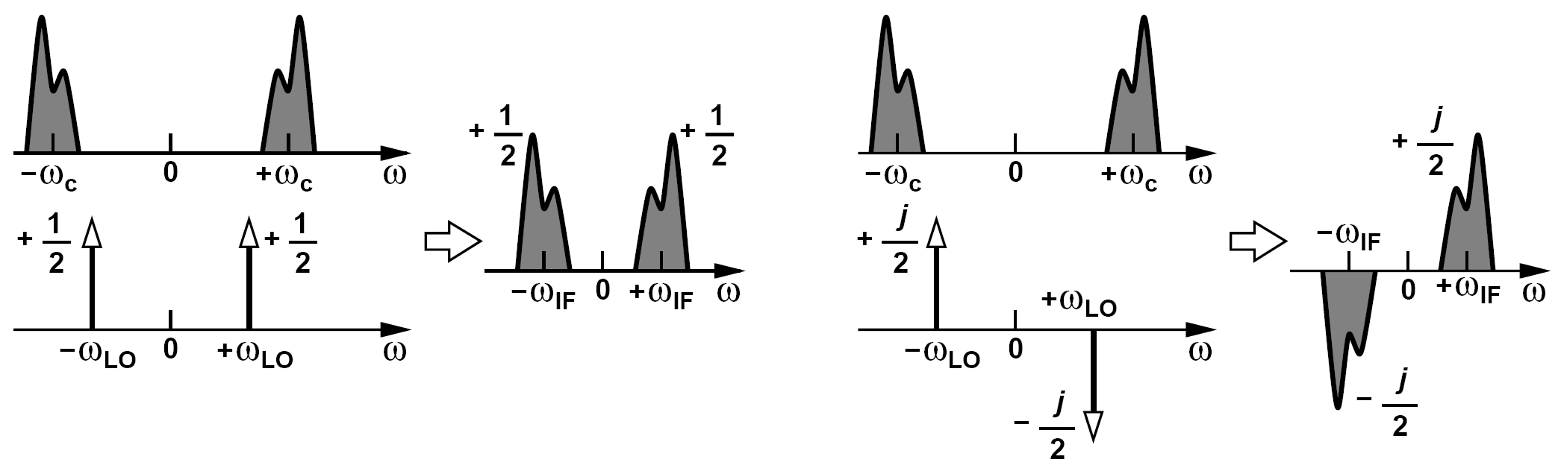
Low-Side Injection of the Above Implementation
The realization above assumes high-side injection for the LO. Repeat the analysis for low-side injection.
Figures below show the spectra for mixing with cos ω_{LO}t and sin ω_{LO}t, respectively. In this case, the IF component in the lower arm is the negative of the Hilbert transform of that in the upper arm.

Slide 21
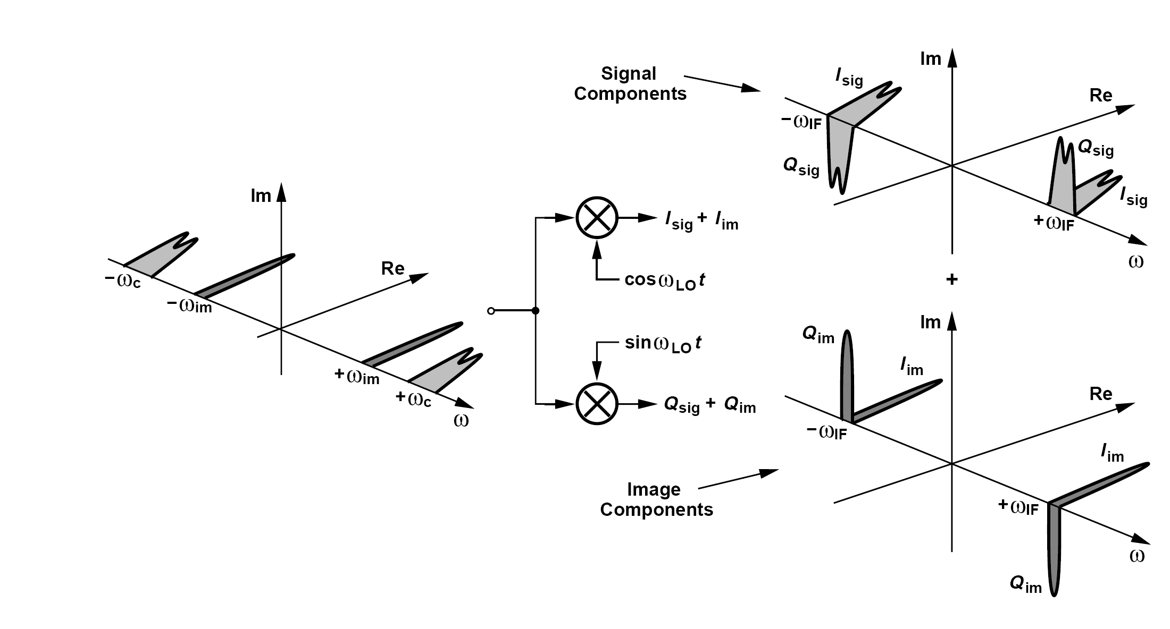
How Can the Image Components Cancel Each Other?
Is I(t) + Q(t) free from the image? Since the image components in Q(t) are 90° out of phase with respect to those in I(t), this summation still contains the image.

Slide 22
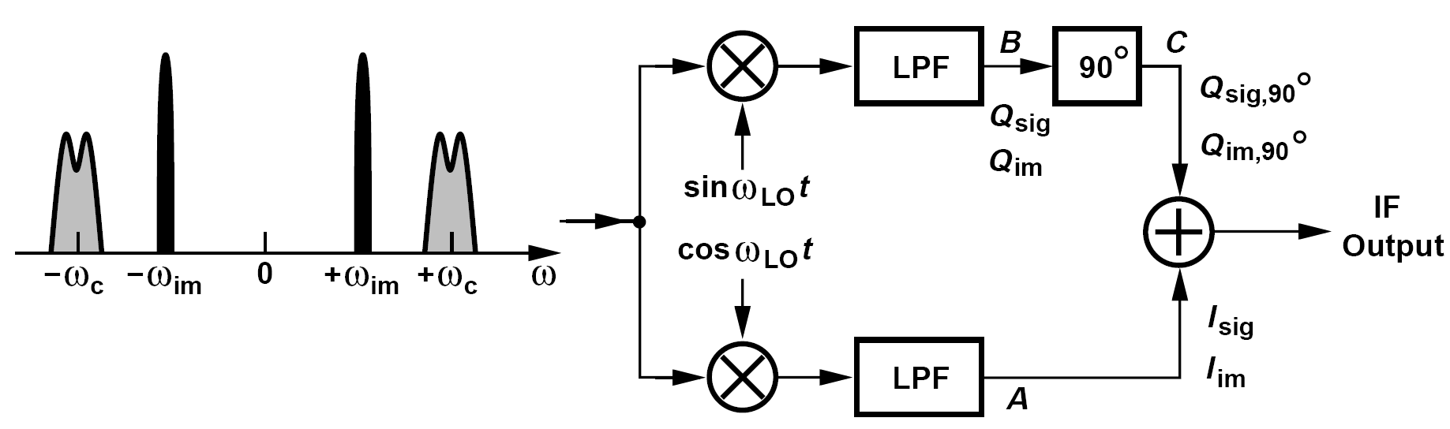
Hartley Architecture
If we shift I(t) or Q(t) by another 90 ° before adding them, the image may be removed.
The low-pass filters are inserted to remove the unwanted high-frequency components generated by the mixers

Slide 23
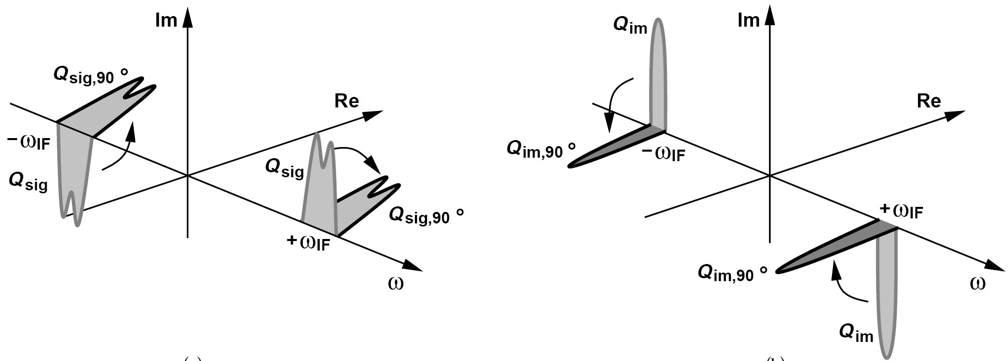
Operation of Hartley’s Architecture
We assume low-side injection and apply a 90° phase shift to the Hilbert transforms of the signal and the image (the Q arm)
.
Multiplication of Q_{sig} by -jsgn(ω) rotates and superimposes the spectrum of Q_{sig} on that of I_{sig}, doubling the signal amplitude. On the other hand, multiplication of Q_{im} by –jsgn(ω) creates the opposite of I_{im}, canceling the image.

Slide 24
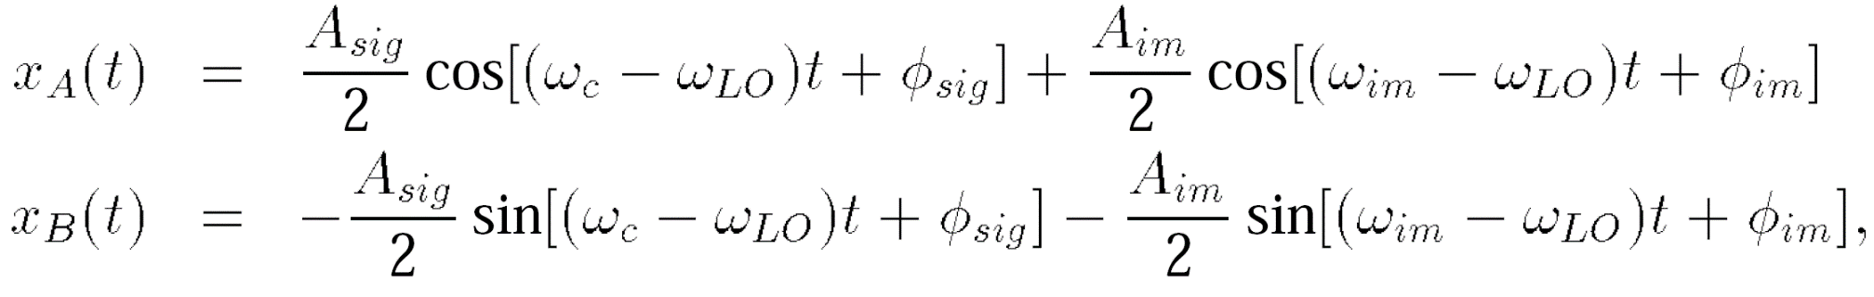
Analytical Expression of Hartley’s Architecture
An eager student constructs the Hartley architecture but with high-side injection. Explain what happens.
We note that the quadrature converter takes the Hilbert transform of the signal and the negative Hilbert transform of the image. Thus, with another 90° phase shift, the outputs C and A in figure above contain the signal with opposite polarities and the image with the same polarity. The circuit therefore operates as a “signal-reject” receiver! Of course, the design is salvaged if the addition is replaced with subtraction.
Represent the received signal and image as x(t) = A_{sig} cos(ω_{c}t + Φ_{sig}) + A_{im} cos(ω_{im}t + Φ_{im}), obtaining the signal at point A and B:
It follows that:
Upon addition of x_{A}(t) and x_{C}(t), we retain the signal and reject the image.
^{The}

Slide 25
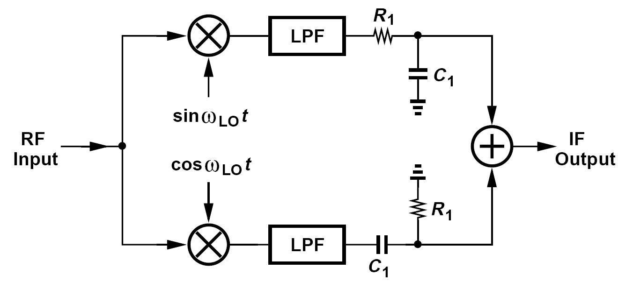
Realization of 90 °Phase Shift of Hartley Architecture
The 90 ° phase shift depicted before is typically realized as a +45 ° shift in one path and -45 ° shift in the other.
This is because it is difficult to shift a single signal by 90 ° while circuit components vary with process and temperature.
Notes:
Drawback : speed, IRR, mismatch
Solution: Weaver , check text book. Home works.

Slide 26
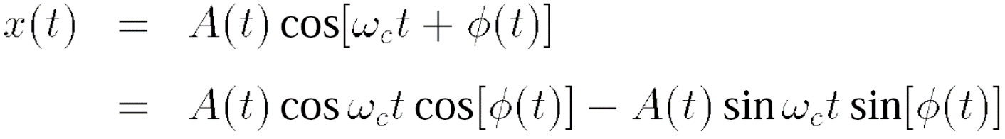
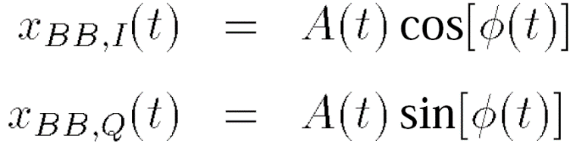
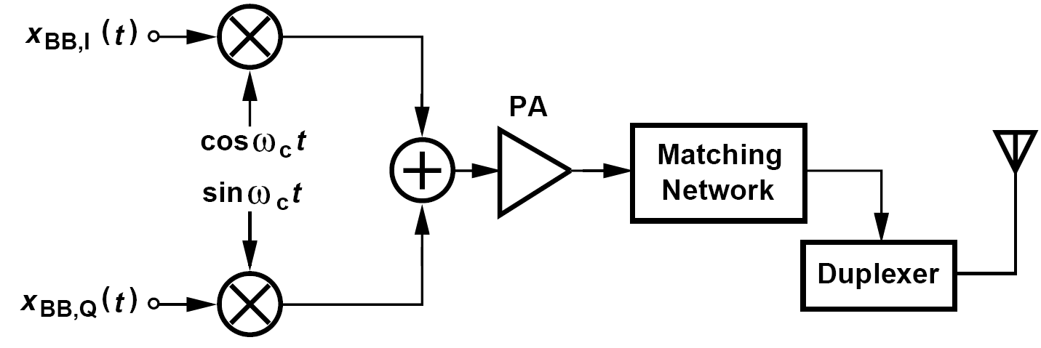
Direct-Conversion Transmitters: Overview
The above expression of a GMSK waveform can be generalized to any narrowband modulated signal:
We therefore define the quadrature baseband signals as
This topology directly translates the baseband spectrum to the RF carrier by means of a “quadrature upconverter”.

Slide 27
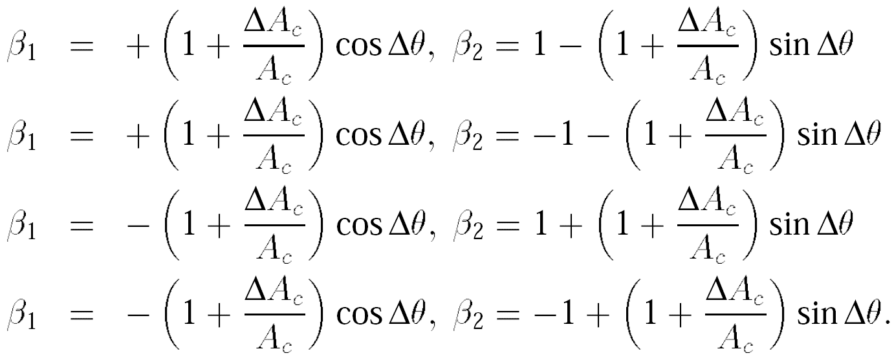
Direct-Conversion Transmitters: I/Q Mismatch
The I/Q mismatch in direct-conversion receivers results in “cross-talk” between the quadrature baseband outputs or, equivalently, distortion in the constellation.
For the four points in the constellation:

Slide 28
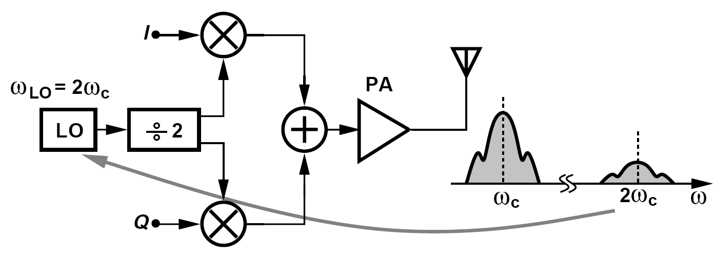
Modern Direct-Conversion Transmitters
Most of today’s direct-conversion transmitters avoid an oscillator frequency equal to the PA output frequency.
This architecture is popular for two reasons:
(1) injection pulling is greatly reduced
(2) the divider readily provides quadrature phases of the carrier

Slide 29
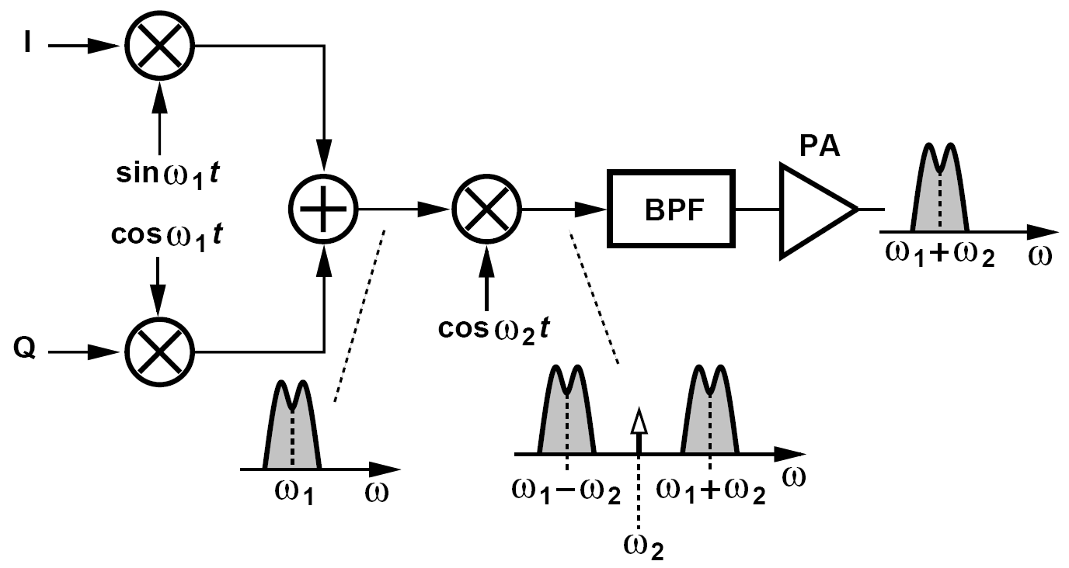
Heterodyne Transmitters
Perform the signal upconversion in two steps so that the LO frequency remains far from the PA output spectrum
As with the receiver counterpart, one advantage of this architecture is that the I/Q upconversion occurs at a significantly lower frequency than the carrier, exhibiting smaller gain and phase mismatches.

Slide 30
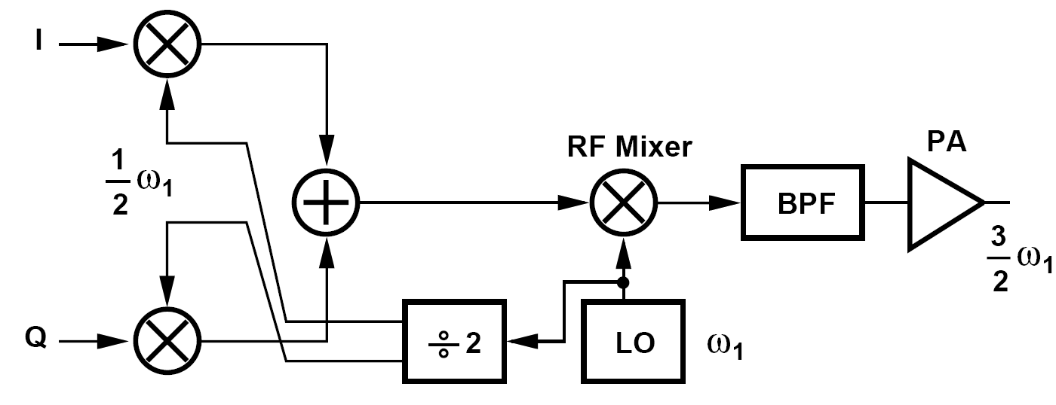
Sliding-IF TX
In analogy with the sliding-IF receiver architecture, we eliminate the first oscillator in the above TX and derive the required phases from the second oscillator
We call the LO waveforms at ω₁/2 and ω₁ the first and second LOs, respectively.

